Slide 1
3MTT CAPSTONE PROJECT COVID 19 DATA EXPLORATION AND ANALYSIS
BY
RAFIYAT OMOLOLA OYENIYI
FE/23/60944262

Slide 2
PROBLEM STATEMENT
In 2020, a new coronavirus, 2019-nCoV, was first identified in Wuhan, China. People developed pneumonia, cough without a clear cause, and existing vaccines or treatments were not effective. The virus was discovered to be transmitted through air and human to human contact. The transmission rate escalated in mid-January 2020.As of 30 January 2020, approximately 8,243 cases were confirmed.

Slide 3
OBJECTIVES
Explore and visualize COVID-19 data to uncover trends and patterns.
Conduct an exploratory data analysis to uncover patterns and insights.
Create visualizations to represent trends in confirmed, recovered, and death cases.
Build predictive models to forecast future cases and classify data trends.
Classify data to gain insights into factors influencing recovery and mortality rates.

Slide 4
DATA SOURCE
The datasets used for the analysis are
1. Covid_19_clean_complete.csv – A time-series dataset tracking global COVID-19 cases.
2. Country_wise_latest.csv – A summary dataset with metrics by country.
https://www.kaggle.com/datasets/imdevskp/corona-virus-report

Slide 5
EXPLORATORY DATA ANALYSIS
From the analysis, we discovered
The Global confirmed, death, and recovery rates peaked at different times, highlighting the virus's progression.
Certain WHO regions had significantly higher death and confirmed cases, indicating unequal impacts of the pandemic.
There is a strong positive correlation between confirmed and death cases observed, while recovery rates varied regionally which helped identify mortality rates by region.

Slide 6
DATA VISUALIZATION
Bar Charts:
Total deaths by WHO regions.
Death counts by continents.
Line Charts:
Global trends over time, displaying confirmed, recovered, and death cases.
Regional trends for confirmed cases across months.
Histograms:
Distribution of confirmed and death cases.
Scatter Plots:
Relationship between confirmed cases and deaths.
Custom Plots:
Death and recovery rates visualized by WHO regions.

Slide 7
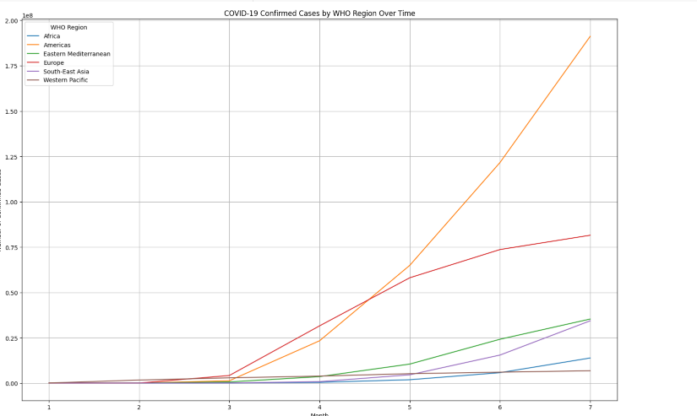
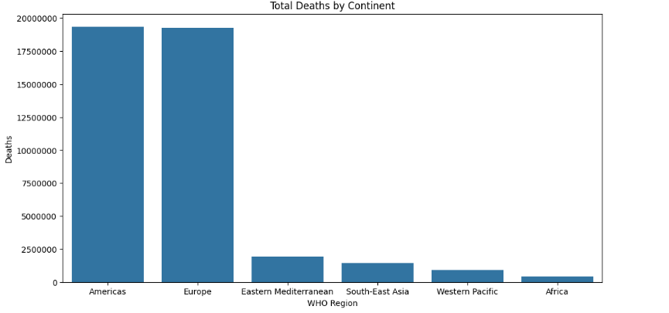

Slide 8
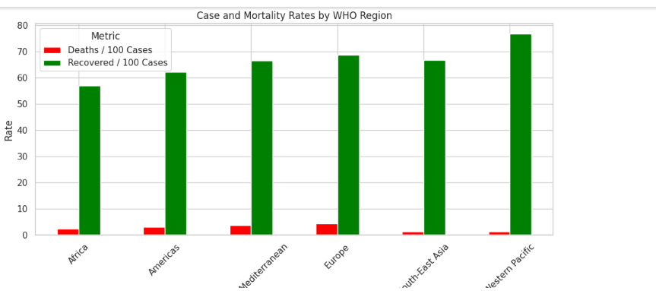
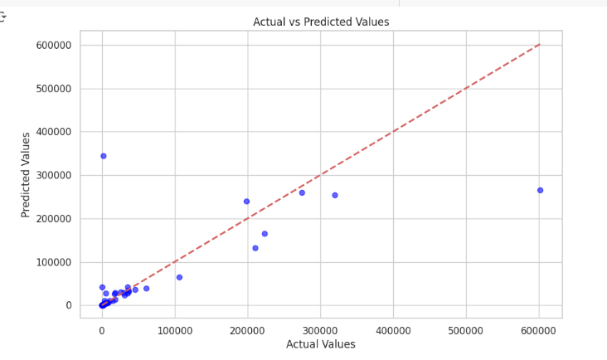

Slide 9
MODELING
Regression Modeling: The objective of using Regression modelling is to predict death counts using features like confirmed cases. We used the Random Forest Regressor.
Time-Series Analysis: The Time-series analysis was used to forecast confirmed cases over time. The model used was ARIMA.
Classification Modeling: The objective of using classification modeling is to classify data trends (e.g., recovery vs. death rates). The model used was the Random Forest Classifier.

Slide 10
CONCLUSION
The project successfully analyzed COVID-19 data, providing key insights into the virus's progression and impacts:
Regional disparities in case counts and death rates were evident, underlining the pandemic's uneven impact.
Predictive modeling highlighted future trends, aiding decision-making for public health policies.
Classification models revealed significant factors affecting recovery and mortality.

Slide 11
RECOMMENDATION
Public Health Planning: Use predictive insights to allocate resources effectively in high-risk regions.
Further Analysis: Incorporate real-time data, such as vaccination rates and new variants, for improved predictions.
Dashboard Development: Build an interactive dashboard to provide dynamic updates on trends and forecasts.

Slide 12
FUTURE WORK
Integrate additional data sources, such as economic indicators or healthcare capacity metrics.
Develop ensemble models for improved accuracy.
Explore the socio-economic impact of COVID-19 using advanced data analytics.

